Slide 1

GDP FORECASTING
By: Madiha Najam, Fatima Zahra El Mansouri, Tanvir, Shehryar Siddiqui
https://github.com/siddi582/PfizerFinalProject-

Slide 2


Overview
Overview
Intro to Macroeconomics
Forecasting GDP
Conclusion
Purpose: To give an overview of Canada’s Macroeconomics

Slide 3
Dataset Overview
Datasets
Source
ETL

Slide 4
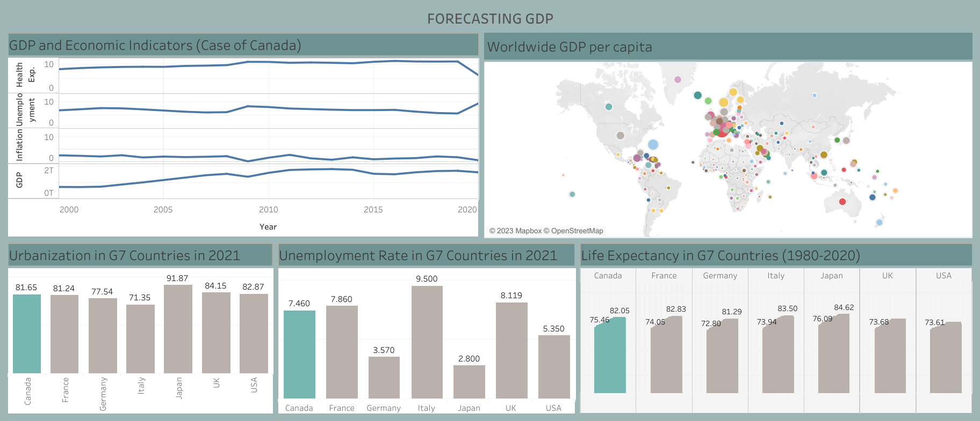
Exploring Canadian Data Link to Dashboard

Slide 5
Exploring Canadian Data Link to Dashboard

Slide 6
Exploring Canadian Data Link to Dashboard

Slide 7
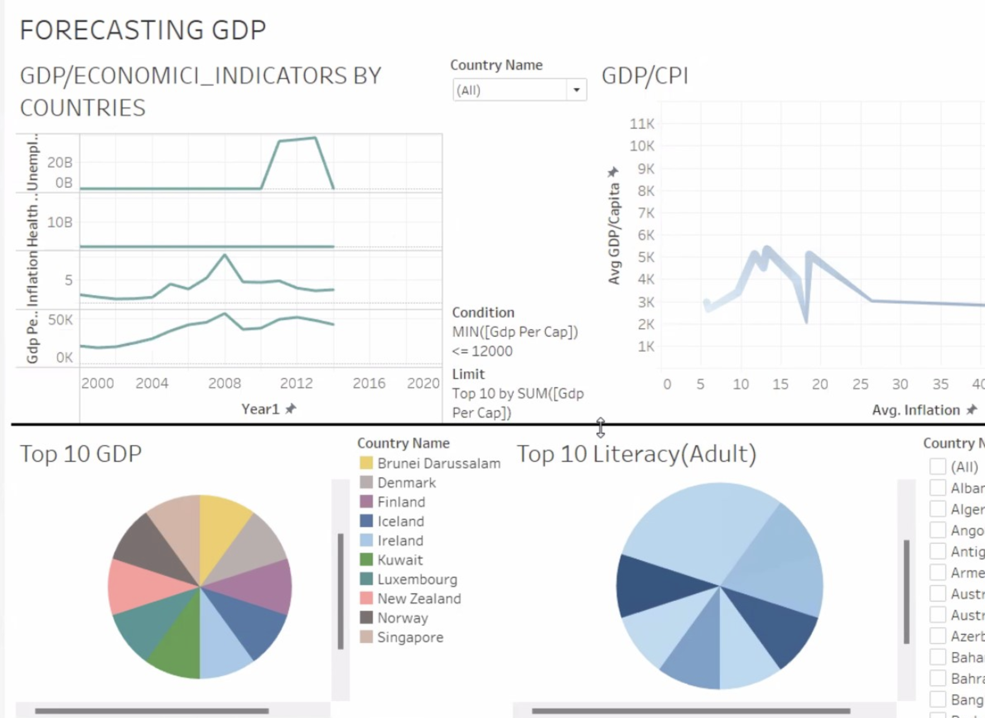
GDP Forecasting
Canada consumes x amount of fossil fuels and x amount of energy , most of the people live in urban areas
More Investments can be made through:
Population Density
Canadian Agriculture
Energy Production
We can assume that that their will be growth in the future in such areas

Slide 8
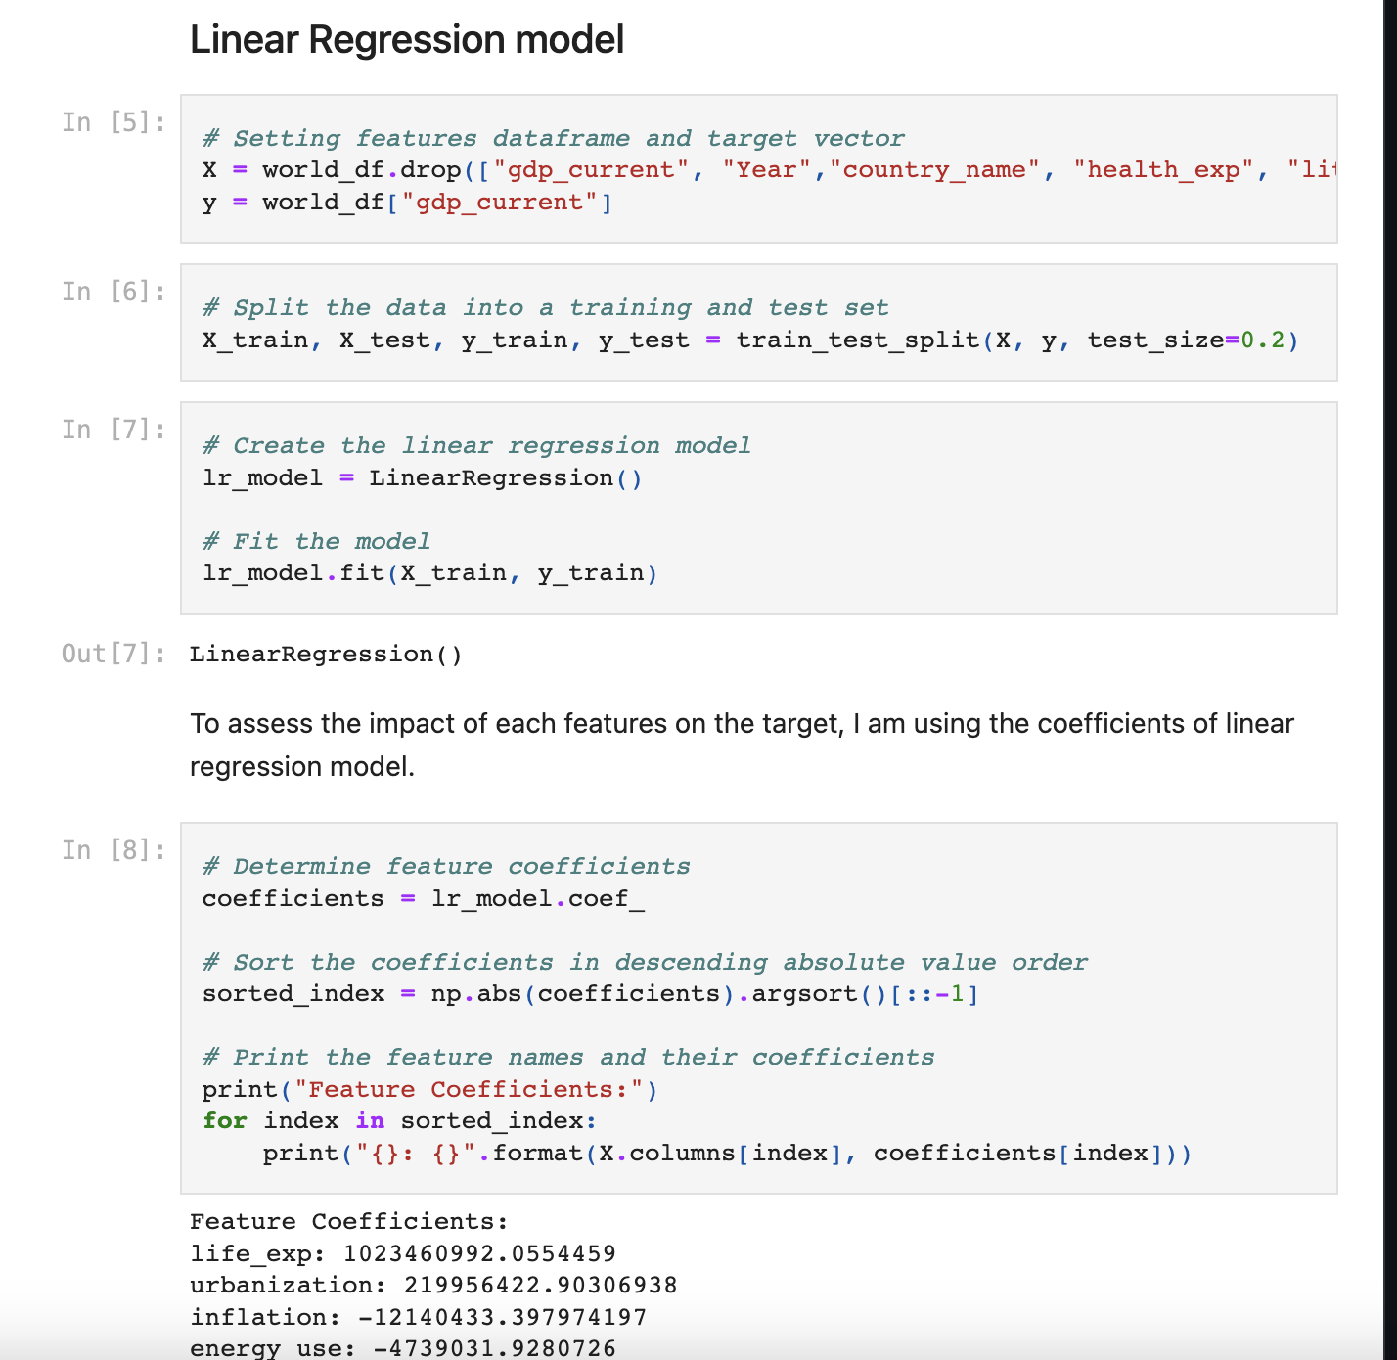
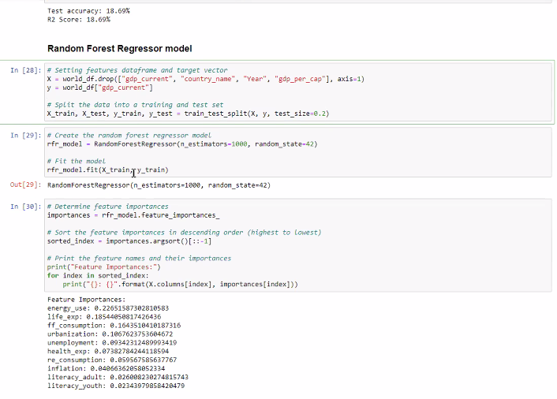
Best MODEL: Linear Regression

Slide 9
ACCURACY TRACKING METHOD

Slide 10
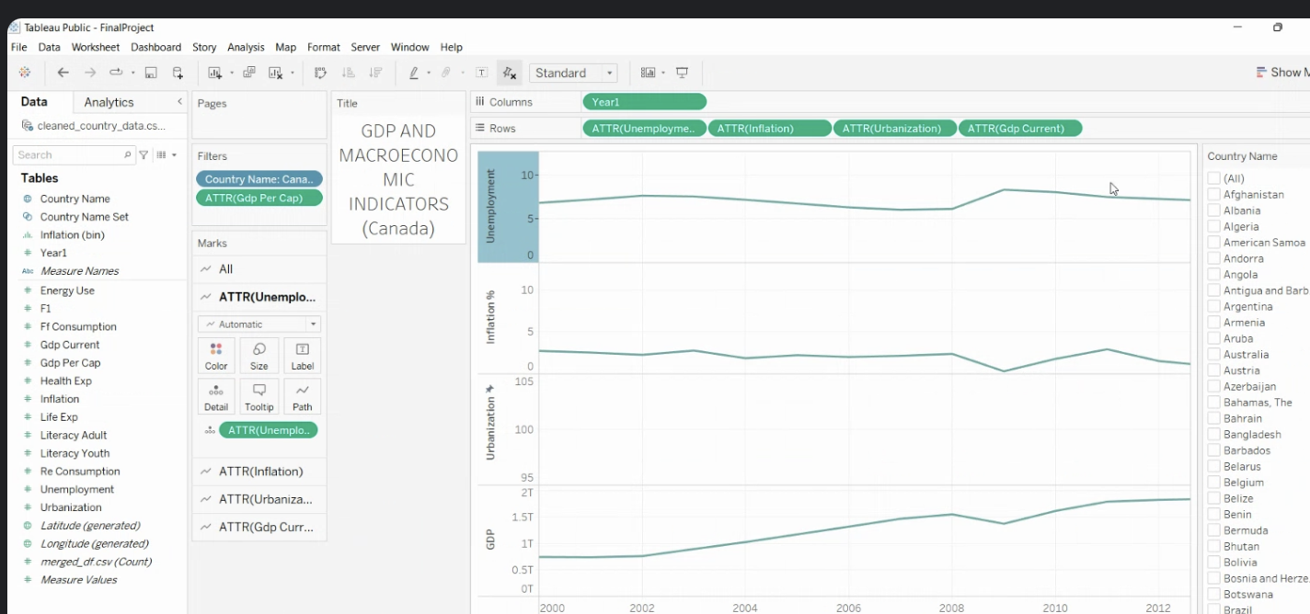
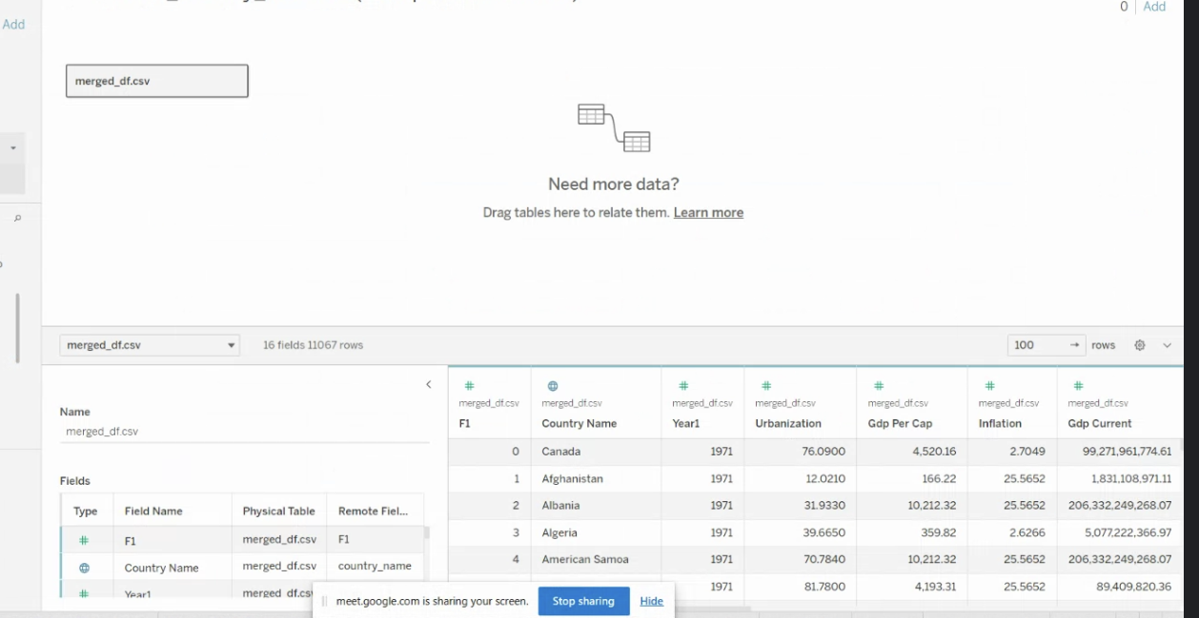
Values
If someone wants to predict GDP, we drop GDP current and country name
They must provide economic indicators

Slide 11
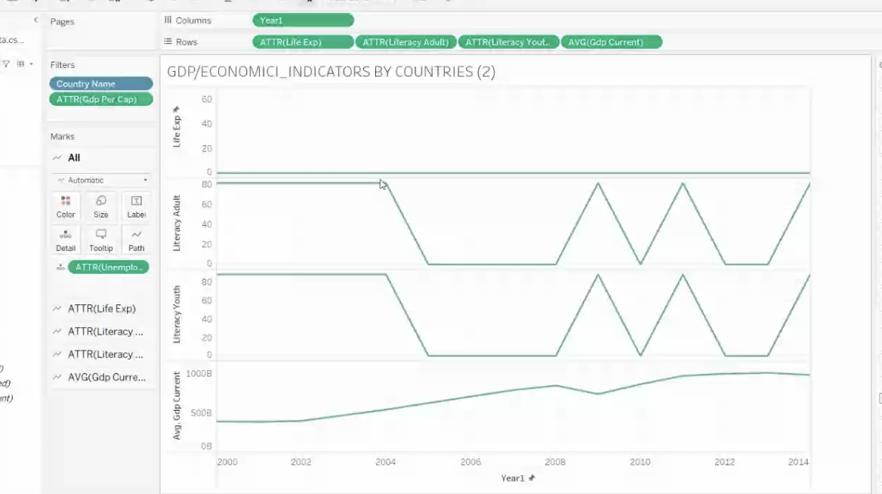
Conclusion

Slide 12
Questions?

